Slide 1
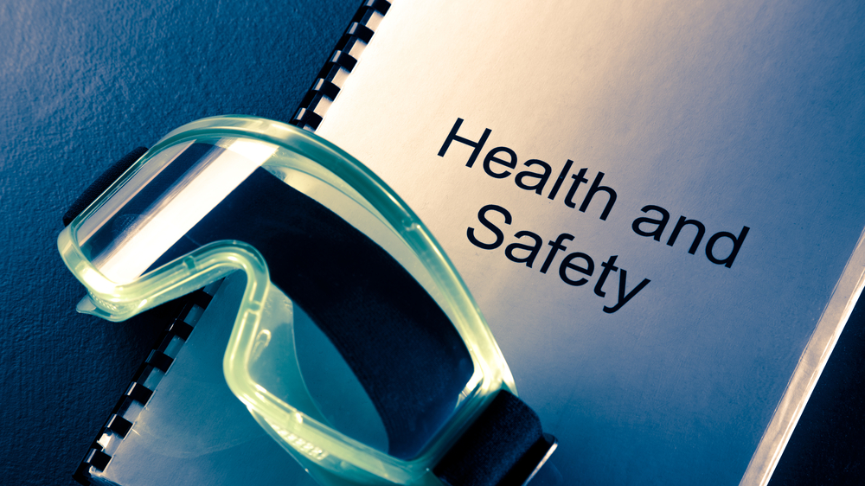

Slide 2

SAFETY HANDBOOK POCKET BOOK STRUCTURE
SAFETY HANDBOOK
Whistleblowing
Toolbox Talks
Risk Assessment
Permit to work
Open Reporting
Daily Work Planner
AHOY App on mobile to Directors
DPA on phone or email
LARP
Re Assess
Open Reporting
MLC and Flag - Complaint

